Slide 1
Unit-4

Slide 2
What is Node.js?
Node.js is an open-source, cross platform JavaScript runtime environment that is built on Chrome's V8 JavaScript engine.
• Node.js lets developers use JavaScript to write command-line tools and for server-side scripting—running scripts server-side to produce dynamic web page content.
• Node.js uses an event-driven, non-blocking I/O model that makes it efficient and lightweight.
• It has a rich ecosystem of modules and packages available through the Node Package Manager (NPM), which allows developers to easily add functionality to their applications.

Slide 3
A common task for a web server can be to open a file on the server and return the content to the client.
How PHP or ASP handles a file request: Sends the task to the computer's file system. 2. Waits while the file system opens and reads the file. 3. Returns the content to the client. 4. Ready to handle the next request. | How Node.js handles a file request: 1. Sends the task to the computer's file system. 2. Ready to handle the next request. 3. When the file system has opened and read the file, the server returns the content to the client.

Slide 4
Advantages of Node.JS
Node.js is open-source meaning it has been made freely available to developers all over the world. Anyone is able to proposed modifications or improvements.
Using Node.js we are able to build entire server-side applications using only JavaScript.
The runtime environment itself is very lightweight. It includes only the core modules needed to function. Any other modules required by the application may be easily installed.
The asynchronous nature of Node.js leads to increased performance over other frameworks.
Node.js may be run on Windows, MAC, or Linux systems.

Slide 5
Key features and aspects of Node.js
1. Event-Driven and Non-Blocking I/O
Node.js operates on a non-blocking, event-driven architecture, making it efficient and suitable for building scalable network applications.
The non-blocking, event-driven architecture is a fundamental aspect of Node.js and many modern software systems, particularly those dealing with I/O (Input/Output) operations. This architecture allows for efficient handling of concurrent operations, especially in networked applications, without the need for multiple threads of execution.
In a non-blocking system, tasks that would typically delay the execution process (like reading from a file system or querying a database) are executed asynchronously. This means the application can initiate an I/O operation and continue to execute other tasks without waiting for the I/O operation to complete. When the operation is completed, a callback function is executed to handle the result, allowing the task to resume where it left off.

Slide 6
2. Built on V8 JavaScript Engine
Node.js is built on the Chrome V8 JavaScript engine, which compiles JavaScript directly to native machine code. This allows Node.js to provide exceptional performance for applications.
The V8 JavaScript engine is an open-source JavaScript engine developed by Google. It is written in C++ and is used in Google Chrome, the open-source browser from Google, as well as in Node.js and other projects. V8 compiles JavaScript directly to native machine code before executing it, rather than interpreting it or compiling it to bytecode. This approach results in significantly faster execution of JavaScript code, which is crucial for performance-critical applications.
Just-In-Time (JIT) Compilation: V8 uses JIT compilation techniques to improve the execution speed of JavaScript. This means that it compiles JavaScript code to machine code at runtime, optimizing the code based on how it's actually being used.

Slide 7
3. npm: Node.js Package Manager
Node.js comes with npm, a powerful package manager that makes it easy to share and reuse code. npm has become one of the largest software registries in the world, offering a vast collection of packages for various functionalities, from web development frameworks to tools for data visualization.
4. Asynchronous Programming Model
Node.js encourages an asynchronous programming model, which can lead to more efficient use of resources and faster application performance, especially in applications that perform a lot of I/O operations.

Slide 8
What Node.js can do?
• Node.js can generate dynamic page content.
• Node.js can create, open, read, write, delete, and close files on the server.
• Node.js can collect form data.
• Node.js can perform CRUD operations on your database.

Slide 9
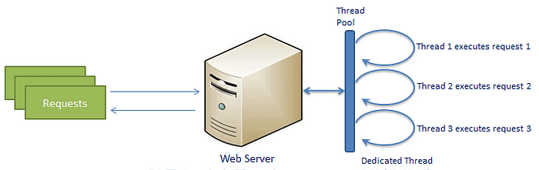
The Traditional Web Server Model
The traditional web server model consists of a pool of threads which may process requests. Each time a new request comes in, it is assigned to a different thread in the pool.
In the event a request is received and a thread is not available, the request will have to wait until a previous request finishes, a response is returned, and the thread is returned to the thread pool.
In this way, the web server model is synchronous, or blocking.

Slide 10
One-to-One Request Handling: In the traditional model, each incoming request typically ties up a single thread or process on the server until the request is fully processed and a response is sent back to the client.
This means the server allocates its resources to handle the request from start to finish, waiting (or "blocking") for any I/O operations like database queries or file access to complete before moving on to the next request.
Sequential Processing: The server processes requests in a sequential manner. If a request requires a time-consuming operation, subsequent requests must wait their turn, creating a bottleneck.
This synchronous approach ensures that requests are processed in order, but at the cost of concurrency and efficiency, especially under heavy load or during long operations.

Slide 11
Limited Scalability: Given that each request can block a server thread or process, the server can handle only as many concurrent requests as it has threads or processes available. To scale up and handle more requests simultaneously, the server needs to increase its hardware capacity.

Slide 12
Node.JS Process Model
Node.js employs a unique process model that sets it apart from traditional web server models, which typically use multiple threads or processes to handle concurrent connections. The core of Node.js's model is based on non-blocking, event-driven I/O operations, allowing it to handle thousands of concurrent connections efficiently.
Node.js runs in a single process with requests being processed on a single thread. It handles all asynchronous I/O operations — such as reading from the filesystem, network requests, or database queries — through events or callbacks, without blocking the main thread.
When a request comes in, it will be placed in an event queue. Node.js uses an event loop to listen for events to be raised for an asynchronous job. The event loop continuously runs, receiving requests from the event queue.

Slide 13
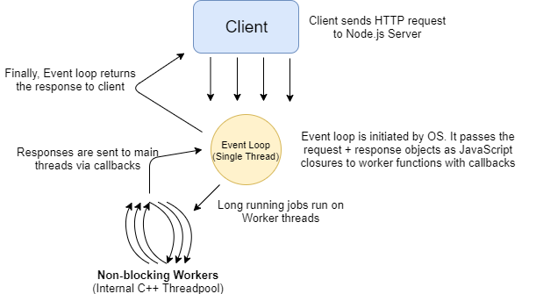
Non-Blocking I/O: When Node.js needs to perform an I/O operation, it will send the operation to be executed in the background or worker thread pool and continue to process other events. Once the operation is completed, Node.js will receive a callback with the operation's result and execute the callback function.

Slide 14
Advantages and Limitations of Node.JS Process Model
Advantages: The event-driven, non-blocking I/O model makes Node.js highly scalable for applications that have a lot of disk or network operations, allowing it to serve a large number of requests with lower hardware requirements compared to traditional multi-threaded servers.
Limitations: While excellent for I/O-bound tasks, Node.js's single-threaded nature can become a limitation for CPU-intensive operations, as these can block the event loop and slow down the application. This is where worker threads or external services for heavy computations can be beneficial.

Slide 15
Datatypes in Node.js
Node.js contains various types of data types similar to JavaScript.
Boolean
Undefined
Null
String
Number
Node.js supports loose typing, which means you don’t need to specify what type of information will be stored in a variable in advance. We use the var and let keywords in Node.js declare any type of variable.

Slide 16
Steps to create and run a node.js file
Running a Node.js program from the console
Make sure you have Node.js installed on your system. You can verify this by running node -v in your console, which should print the version of Node.js installed.
Create a Node.js File: Create a JavaScript file that contains your Node.js code. You can do this using any text editor.
Write Your Node.js Code: Inside the file, write some Node.js code.
For Example: console.log('Hello, World!’);
4. Open the console and navigate to your File’s directory
5. Run your node.js program
node file.js

Slide 17
Running a Node.js program from the browser
Node is just a way for you to run JavaScript outside the browser. It can be used to run desktop app servers or anything else that you want to do with JavaScript. We can also create a web server using node.js.
Node.js HTTP Module
• Node js has a built in module called HTTP, which allows Node js to transfer data over the Hyper Text Transfer Protocol ( HTTP).
• To include the HTTP module, use the require() method
Var http = require('http')

Slide 18
Creating an app.js file with the following code.
Inside this file we need to create our server and tell to start listening on a certain port, So firstly we need to require a certain library called HTTP which will preclude the HTTP library into our code inside of this HTTP variable that we created.
const http = require('http')
const port = 8080
const server = http.createServer(function (req, res) {
// Write a response to the client
res.write('Hello World')
res.end()
})

Slide 19
var http = require('http');
//create a server object:
http.createServer(function (req, res) {
res.write('Hello World!');
res.end();
}).listen(8080);

Slide 20
Functions in Node.js
Node.js functions are defined using the function keyword then the name of the function and parameters which are passed in the function.
In Node.js, we don’t have to specify datatypes for the parameters and check the number of arguments received. Node.js functions follow every rule which is there while writing JavaScript functions.
function multiply(num1, num2)
{
return num1 * num2;
}
let x = 2;
let y = 3;
console.log("Multiplication of", x, "and" y, "is", multiply(x, y));

Slide 21
Node.JS REPL
The node:repl module provides a Read-Eval-Print-Loop (REPL) implementation that is available both as a standalone program or includible in other applications.
To start it, simply enter node in your command line shell. The > symbol lets you know that you can enter JavaScript code to be immediately evaluated.
Read : It reads the inputs from users and parses it into JavaScript data structure. It is then stored to memory.
Eval : The parsed JavaScript data structure is evaluated for the results.
Print : The result is printed after the evaluation.
Loop : Loops the input command.

Slide 22
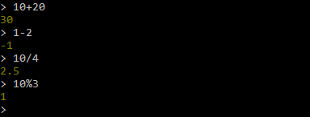

Slide 23
We have created a server variable here that uses the HTTP library and called the create server function on this object and this creates a server function that has two parameters which are the request and response parameters.
Set up our server so it will listen on the port that we want so that we have this server object pass it that port variable that we created to tell it to listen on port 8080 and then this takes a single function that it will call if there is an error potentially or it was successful.

Slide 24
Node.Js Modules
Node.js modules are essentially reusable blocks of code that can be imported and used in Node.js applications.
They allow developers to organize their code into separate files and packages, which can be easily managed and shared. There are three main types of modules in Node.js:
Core Modules: These are modules that come bundled with Node.js itself.
Examples include fs for file system operations, http for HTTP server and client functionality, path for file path manipulation, and many others.
These modules provide foundational functionalities that are essential for building applications with Node.js.

Slide 25
Local Modules: These are custom modules created by developers to organize their application's code. You can create a module by writing JavaScript code in a file and exporting functions, objects, or values using module.exports or exports. Other files in the application can then use the require function to import these exports.
Third-party Modules: Also known as external or npm (Node Package Manager) modules, these are modules that are developed by the community and published to the npm registry. Developers can install these modules into their projects using the npm CLI (command-line interface) with commands like npm install <module-name>. Examples of popular third-party modules include express for web application frameworks, mongoose for MongoDB object modeling, and react for building user interfaces.

Slide 26
Core Module (fs module) Node.js File System
The Node.js fs (File System) module is a key part of the Node.js API, providing a wide array of functionalities to interact with the file system on a computer.
This module can be used for reading from and writing to files, as well as handling directories, streams, and more, directly from Node.js scripts.
Before you can use the fs module in your Node.js application, you need to import it. This is typically done using the require function.
var fs = require('fs');

Slide 27
Common use for the File System module:
1. Read files
2. Create files
3. Update files
4. Delete files
5. Rename files
Synchronous approach: They are called blocking functions as it waits for each operation to complete, only after that, it executes the next operation, hence blocking the next command from execution.
Asynchronous approach: They are called non-blocking functions as it never waits for each operation to complete, rather it executes all operations in the first go itself. The result of each operation will be handled once the result is available i.e. each command will be executed soon after the execution of the previous command.

Slide 28
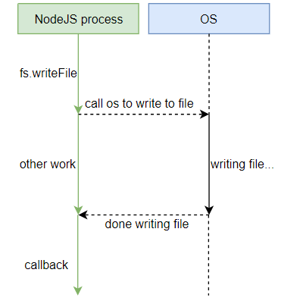
Asynchronous approach

Slide 29
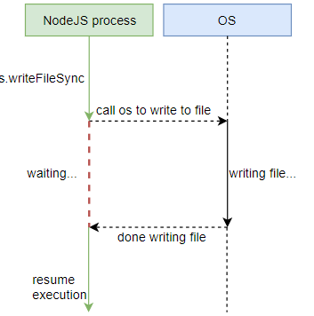
Synchronous approach

Slide 30
Open a File
Syntax
fs.open(path, flags[, mode], callback)
Parameters
path - string having file name including path.
flags - Flag tells the behavior of the file to be opened.
mode - This sets the file mode permission. It defaults to 0666, readable and writeable.
callback - This is the callback function which gets two arguments err, fd.

Slide 31
Flag Description
r Open file for reading. An exception occurs if the file does not exist.
r+ Open file for reading and writing. An exception occurs if the file does not exist.
rs Open file for reading in synchronous mode.
rs+ Open file for reading and writing, telling the OS to open it synchronously.
w Open file for writing. The file is created if it does not exist or truncated if it exists.
wx Like 'w' but fails if path exists.
w+ Open file for reading and writing. The file is created if it does not exist or truncated if it exists.
wx+ Like 'w+' but fails if path exists.
a Open file for appending. The file is created if it does not exist.
ax Like 'a' but fails if path exists.
a+ Open file for reading and appending. The file is created if it does not exist.

Slide 32
Opening a File
var fs = require("fs");
console.log("opening file!");
fs.open(‘try.txt', 'r+', function(err, fd) {
if (err) {
return console.error(err);
}
console.log("File opened successfully");
});

Slide 33
Reading contents from a file
Asynchronous read
var fs = require("fs");
fs.readFile(‘try.txt', function (err, data) {
if (err) {
return console.error(err);
}
console.log("Asynchronous read: " + data.toString());
});

Slide 34
Synchronous read
var fs = require("fs");
var data = fs.readFileSync(‘try.txt');
console.log("Synchronous read: " + data.toString());

Slide 35
Reading using read method
fs.read(fd, buffer, offset, length, position, callback)
fd - This is the file descriptor returned by file fs.open method.
buffer - This is the buffer that the data will be written to.
offset - This is the offset in the buffer to start writing at.
length - This is an integer specifying the number of bytes to read.
position - This is an integer specifying where to begin reading from in the file. If position is null, data will be read from the current file position.
callback - This is the callback function which gets the three arguments, err, bytesRead, buffer.

Slide 36
var fs = require("fs");
var buf = new Buffer(512);
fs.open(‘try.txt', 'r+', function(err, fd) {
if (err) {
return console.error(err);
}
console.log("File opened successfully!");
fs.read(fd, buf, 0, buf.length, 0, function(err, bytes){
if (err){
console.log(err);
}
console.log(bytes + " bytes read");
console.log(buf.slice(0, bytes).toString());
});
});

Slide 37
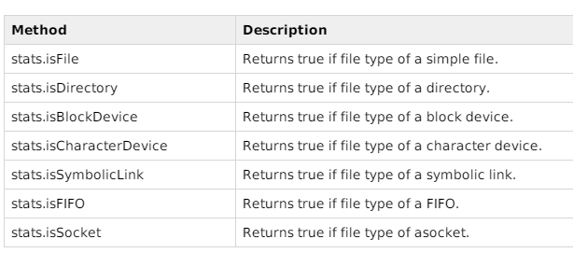
Getting File information
fs.stat(path, callback)
path - This is string having file name including path.
callback - This is the callback function which gets two arguments err, stats where stats is an object of fs.Stats type.

Slide 38
var fs = require("fs");
fs.stat('input.txt', function (err, stats) {
if (err) {
return console.error(err);
}
console.log(stats);
console.log("isFile ? " + stats.isFile());
console.log("isDirectory ? " + stats.isDirectory());
});

Slide 39
Writing File
fs.writeFile(filename, data[, options], callback)
This method will over-write the file if file already exists.
path - This is string having file name including path.
data - This is the String or Buffer to be written into the file.
options - The third parameter is an object which will hold {encoding, mode, flag}. By default encoding is utf8, mode is octal value 0666 and flag is ‘w’.
callback - This is the callback function which gets a single parameter err and used to to return error in case of any writing error.

Slide 40
var fs = require("fs");
console.log("Writing to File");
fs.writeFile(‘try.txt', ‘WebTech Class', function(err) {
if (err) {
return console.error(err);
}
console.log("Data written successfully!");
});

Slide 41
Closing File
fs.close(fd, callback)
fd - This is the file descriptor returned by file fs.open method.
callback - This is the callback function which gets no arguments other than a possible exception are given to the completion callback.
fs.close(fd, function(err){
if (err){
console.log(err);
}
console.log("File closed successfully.");

Slide 42
Delete File
fs.unlink(path, callback)
path - This is the file name including path.
callback - This is the callback function which gets no arguments other than a possible exception are given to the completion callback.
var fs = require("fs");
fs.unlink(‘try.txt', function(err) {
if (err) {
return console.error(err);
}
console.log("File deleted successfully!");
});

Slide 43
Node event driven framework

Slide 44
Node.js is well-known for its event-driven architecture, primarily used to build scalable network applications.
In this architecture, Node.js operates on a non-blocking, single-threaded event loop, enabling it to handle many connections simultaneously in a highly efficient manner.
Some of the Key Components are:
Event-Driven: Everything that happens in Node.js is in response to an event, whether it's reading a file, making a network request, or sending data to a database. This makes it particularly well-suited for tasks that involve I/O operations.
Single-Threaded Event Loop: Node.js uses a single thread for the event loop. However, it can use multiple threads in the background for certain operations (like file I/O) via its libuv library, which it relies on for asynchronous I/O.

Slide 45
Non-Blocking I/O: This is a core feature. Node.js makes I/O operations like network communication, file operation, and database queries non-blocking. This means that Node.js can process other tasks while waiting for the completion of these operations, which significantly enhances its efficiency for certain types of applications.
Callbacks: A callback is a function called at the completion of a given task, preventing any blocking and allowing other code to be run in the meantime. The use of callbacks is at the heart of Node.js asynchronous programming model.
EventEmitter: Node.js has a built-in module called events where you can create, fire, and listen for your own events. The EventEmitter class is used to bind events and event listeners.

Slide 46
const EventEmitter = require('events');
class MyEmitter extends EventEmitter {}
const myEmitter = new MyEmitter();
myEmitter.on('event', () => {
console.log('an event occurred!');
});
myEmitter.emit('event');
A class MyEmitter is created extending EventEmitter.
An instance of MyEmitter is created.
An event listener is added for the 'event', which logs a message when the event is triggered.
The event 'event' is emitted, causing the listener's function to execute.

Slide 47
Event Emitter class
The EventEmitter class in Node.js is a part of the events module, which provides the foundation for managing and handling events. The class allows objects to emit named events that cause previously registered listeners to be called.
1. Importing the EventEmitter Class
Before you can use the EventEmitter class, you need to import it from the events module:
const EventEmitter = require('events');
2. Creating an EventEmitter Instance
You can create an instance of the EventEmitter class either by instantiating EventEmitter directly or by extending it in a custom class:
const emitter = new EventEmitter();
or
class MyEmitter extends EventEmitter {}
const myEmitter = new MyEmitter();

Slide 48
3. Adding Event Listeners
You can add event listeners using the .on() or .addListener() methods. These listeners will be invoked when the event is emitted:
emitter.on('event', function(a, b) {
console.log(a, b, this);
});
// Alternatively using addListener
emitter.addListener('event', function(a, b) {
console.log(a, b, this);
});
4. Emitting Events
You can trigger an event using the .emit() method. This method allows you to pass arguments to the event listeners:
emitter.emit('event', 'a', 'b');

Slide 49
Extending the EventEmitter class and add custom functionality to it.
const EventEmitter = require('events');
class Calculator extends EventEmitter {
constructor() {
super();
this.on('add', (a, b) => {
const result = a + b;
this.emit('result', result);
});
this.on('result', (result) => {
console.log(`The sum is: ${result}`);
});
}
addNumbers(a, b) {
this.emit('add', a, b);
}
}
const calc = new Calculator();
calc.addNumbers(5,3);

Slide 50
Calculator Class: A custom class Calculator is derived from EventEmitter.
Event Handlers: Inside the constructor, two event listeners are set up:
The first listener responds to the 'add' event by calculating the sum of two numbers and then emits a 'result' event with the computed result.
The second listener responds to the 'result' event by logging the result to the console.
addNumbers Method: A method that triggers the 'add' event with two numbers as arguments.
Using the Calculator: An instance of Calculator is created, and the addNumbers method is called with two sample numbers (5 and 3).

